Slide 1
Chapter 3: Geometric Transformations
Sang Il Park
Dept. of Software

Slide 2
Geometric objects and Its representations

Slide 3
Scalars
Scalars α, β, γ from a scalar field
Operations α+β, α∙β, 0, 1, -α, ( )⁻¹
“Expected” laws apply
Examples: rationals or reals with addition and multiplication

Slide 4
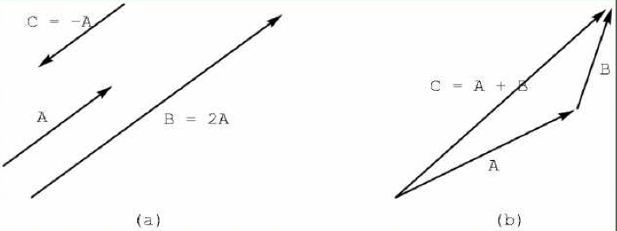
Vectors
Vectors u, v, w from a vector space
Vector addition u + v , subtraction u - v
Zero vector 0
Scalar multiplication α v

Slide 5
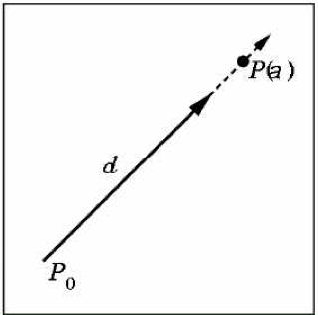
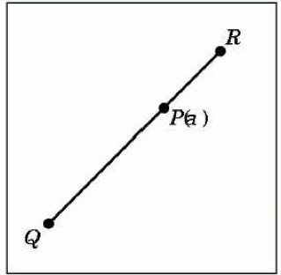
Lines and line Segments
Parametric form of line:
Line segment between Q and R:

Slide 6
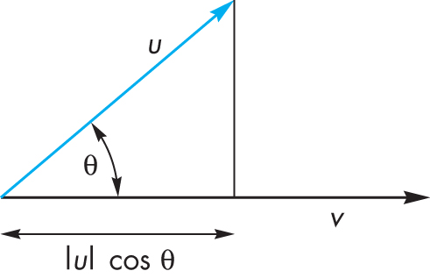
Dot Product (Projection)
Dot product projects one vector onto another vector

Slide 7
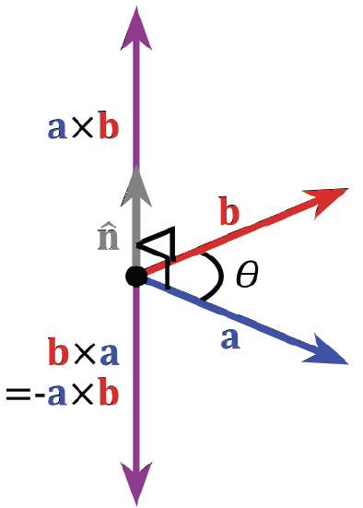
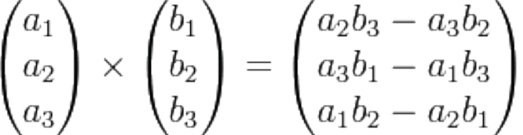
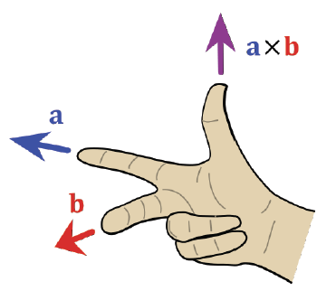
Cross Product
Cross product is perpendicular to both a and b
Right-hand rule

Slide 8
Planes
A plane can be defined by a point and two vectors or by three points
P
v
Q
R
u
R
P(α,β)=R+αu+βv
P(α,β)=R+α(Q-R)+β(P-Q)

Slide 9
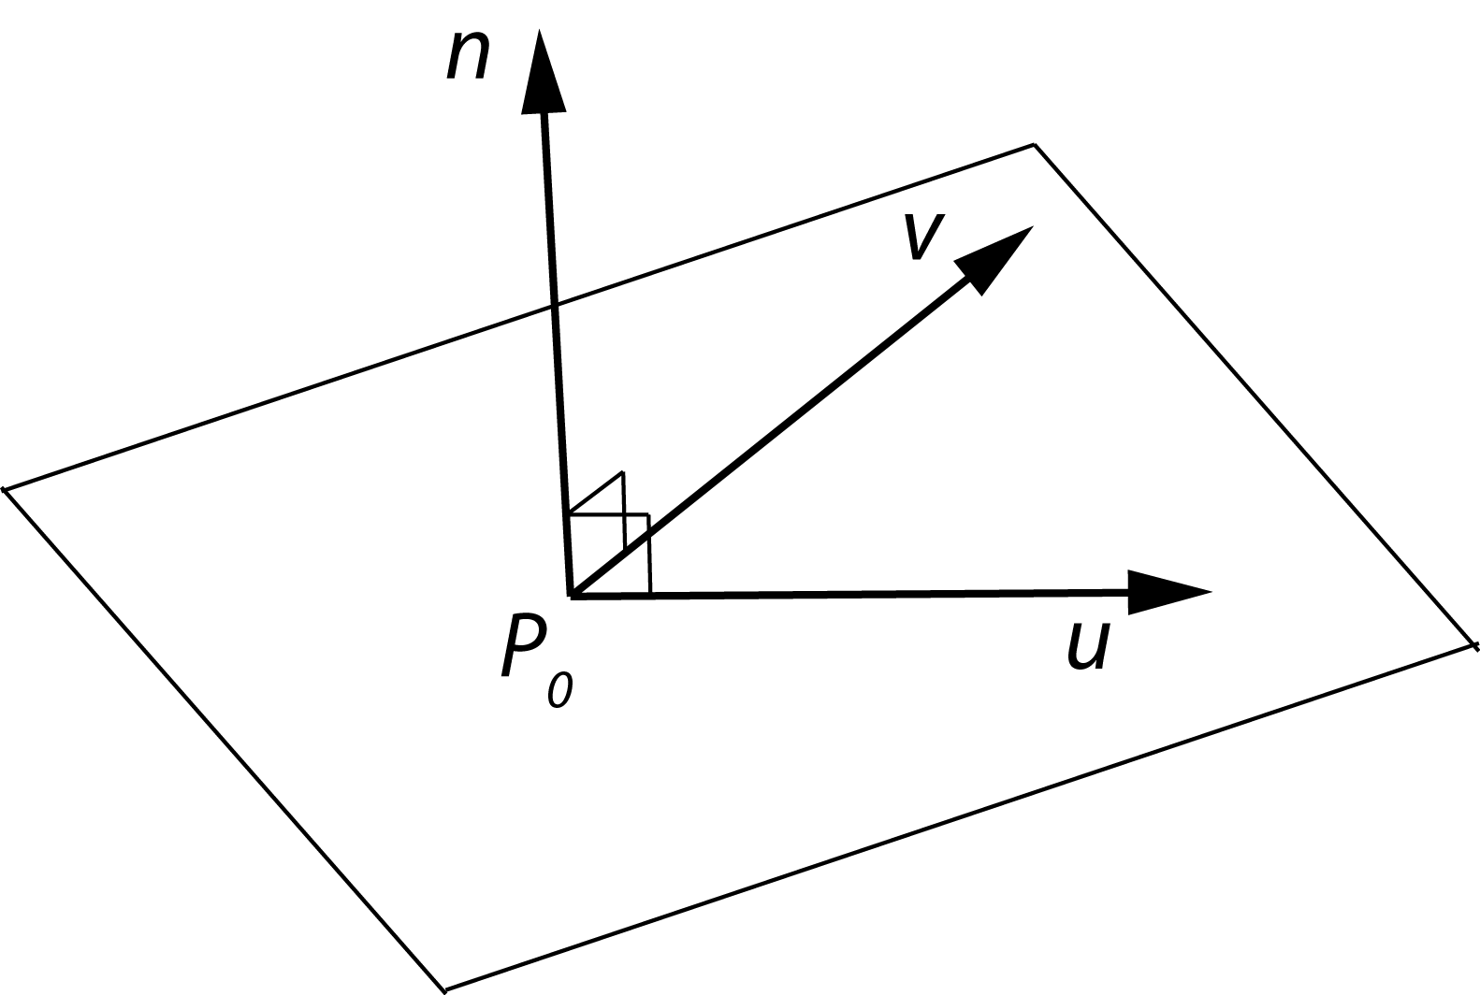
Planes and normal
Plane defined by point P₀ and vectors u and v
u and v should not be parallel
Parametric form: T(α, β) = P₀ + α u + β v (α and β are scalars)
n = u x v / |u x v| is the normal
n∙(P – P₀) = 0 if and only if P lies in plane

Slide 10
Geometric Transformations

Slide 11
Transformations
Linear transformations
Rigid transformations
Affine transformations
Projective transformations
T
Global reference frame

Slide 12
Homogeneous Coordinates
Any affine transformation between 3D spaces can be represented by a 4x4 matrix
Affine transformation is linear in homogeneous coordinates

Slide 13
Projective Spaces
Homogeneous coordinates
(x, y, z, w) = (x/w, y/w, z/w, 1)
Useful for handling perspective projection
But, it is algebraically inconsistent !!

Slide 14
Examples of Affine Transformations
2D rotation
2D scaling

Slide 15
Examples of Affine Transformations
2D shear
2D reflection

Slide 16
Examples of Affine Transformations
2D translation

Slide 17
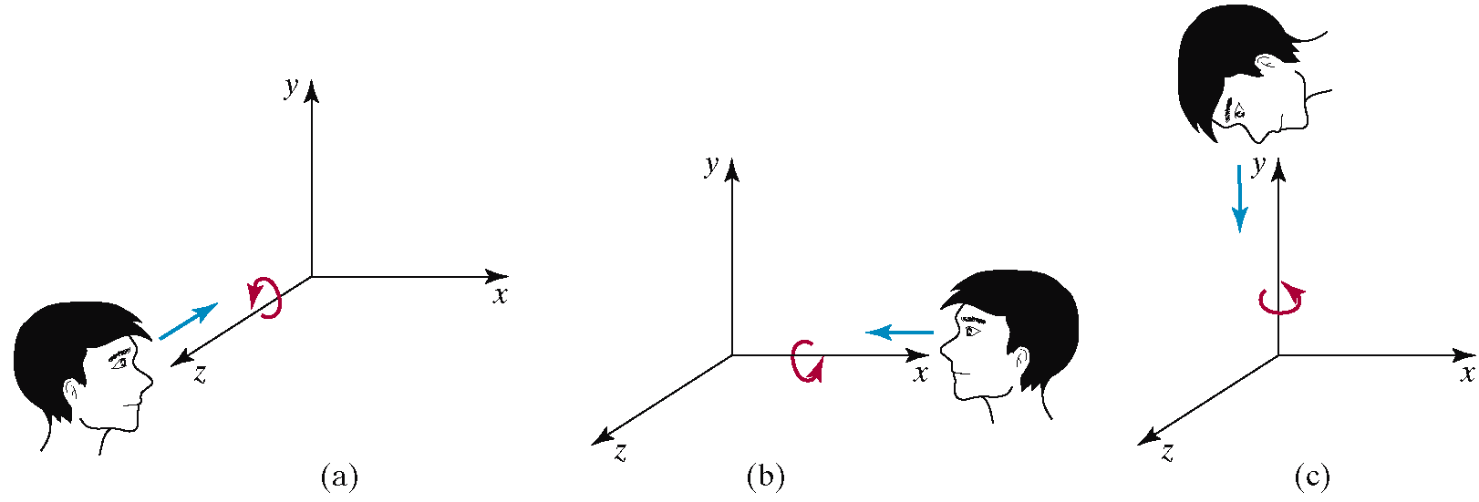
Examples of Affine Transformations
3D rotation

Slide 18
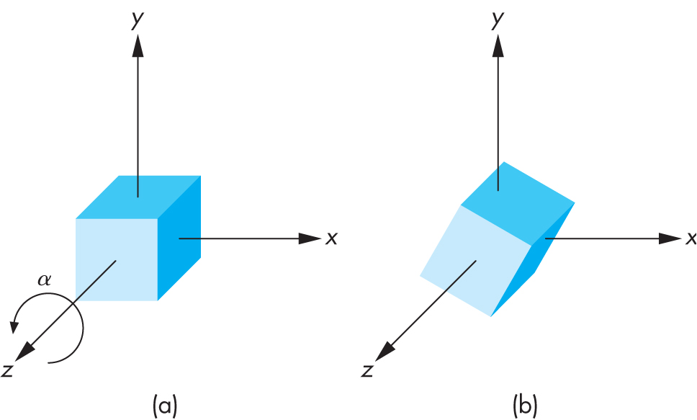
3D Rotation Matrix about Z Axis
R = R_{z}(θ) =

Slide 19
3D Rotation about x and y axes
Same argument as for rotation about z axis
For rotation about x axis, x is unchanged
For rotation about y axis, y is unchanged
R = R_{x}(θ) =
R = R_{y}(θ) =

Slide 20
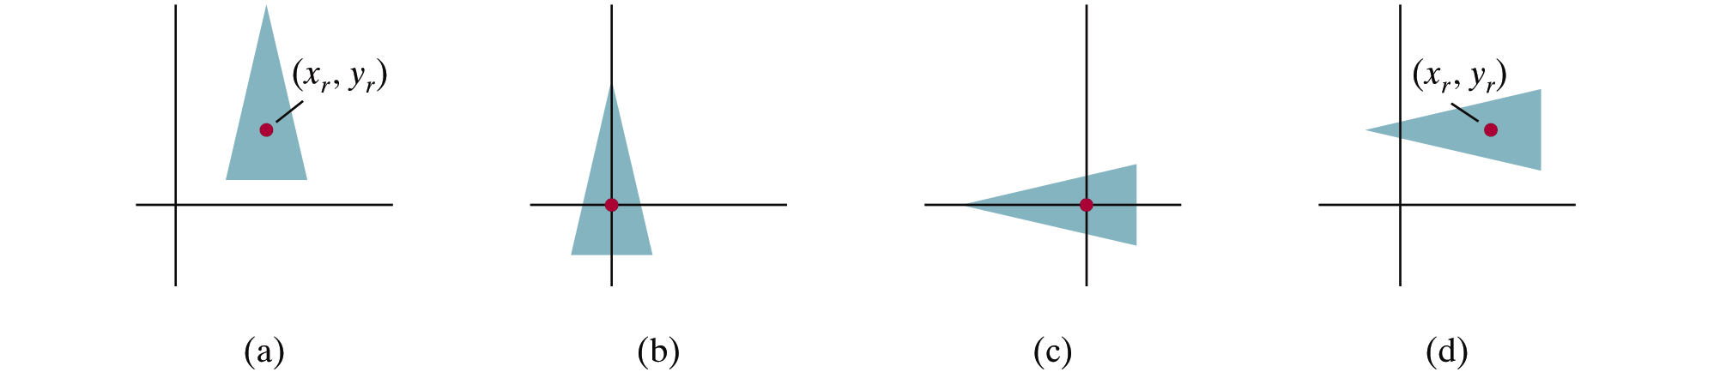
2D Pivot-Point Rotation
Rotation with respect to a pivot point (x,y)

Slide 21
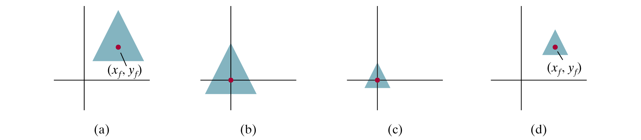
2D Fixed-Point Scaling
Scaling with respect to a fixed point (x,y)

Slide 22
Scaling Direction
Scaling along an arbitrary axis

Slide 23
Properties of Affine Transformations
Any affine transformation between 3D spaces can be represented as a combination of a linear transformation followed by translation
An affine transf. maps lines to lines
An affine transf. maps parallel lines to parallel lines
An affine transf. preserves ratios of distance along a line
An affine transf. does not preserve absolute distances and angles

Slide 24
Rigid Transformations
A rigid transformation T is a mapping between affine spaces
T maps vectors to vectors, and points to points
T preserves distances between all points
T preserves cross product for all vectors (to avoid reflection)
In 3-spaces, T can be represented as

Slide 25
Rigid Body Rotation
Rigid body transformations allow only rotation and translation
Rotation matrices form SO(3)
Special orthogonal group
(Distance preserving)
(No reflection)

Slide 26
Rigid Body Rotation
R is normalized
The squares of the elements in any row or column sum to 1
R is orthogonal
The dot product of any pair of rows or any pair columns is 0
The rows (columns) of R correspond to the vectors of the principle axes of the rotated coordinate frame

Slide 27
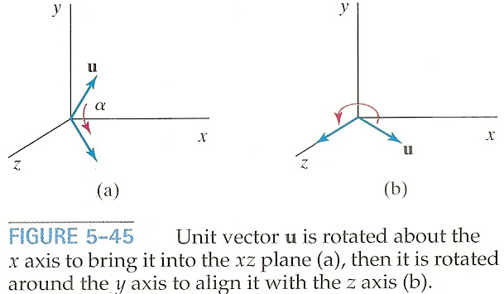
3D Rotation About Arbitrary Axis
How to rotate around u vector (u = given rotation axis)
➔ Rotate about x and y axes to make u align with the z-axis

Slide 28
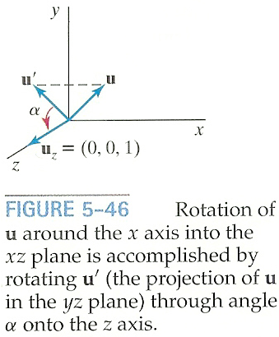
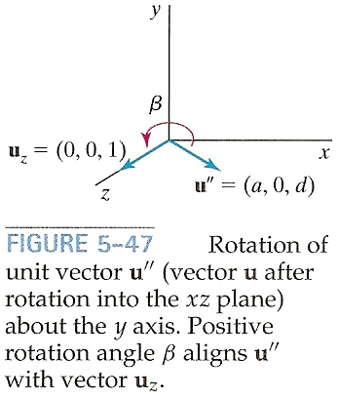
3D Rotation About Arbitrary Axis
Rotate u onto the z-axis
u’: Project u onto the yz-plane to compute angle α
u’’: Rotate u about the x-axis by angle α
Rotate u’’ onto the z-asis

Slide 29
3D Rotation About Arbitrary Axis
Rotate u’ about the x-axis onto the z-axis
Let u=(a,b,c) and thus u’=(0,b,c)
Let uz=(0,0,1)

Slide 30
3D Rotation About Arbitrary Axis
Rotate u’ about the x-axis onto the z-axis
Since we know both cos α and sin α, the rotation matrix can be obtained
Or, we can compute the signed angle α
Do not use acos() since its domain is limited to [-1,1]

Slide 31
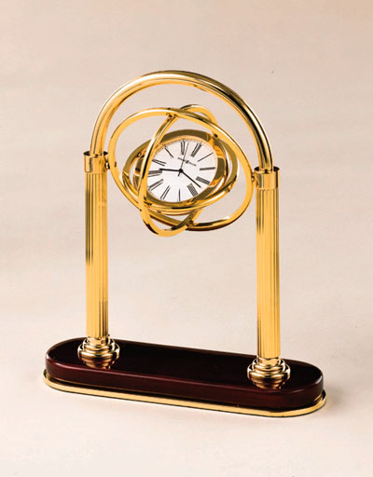
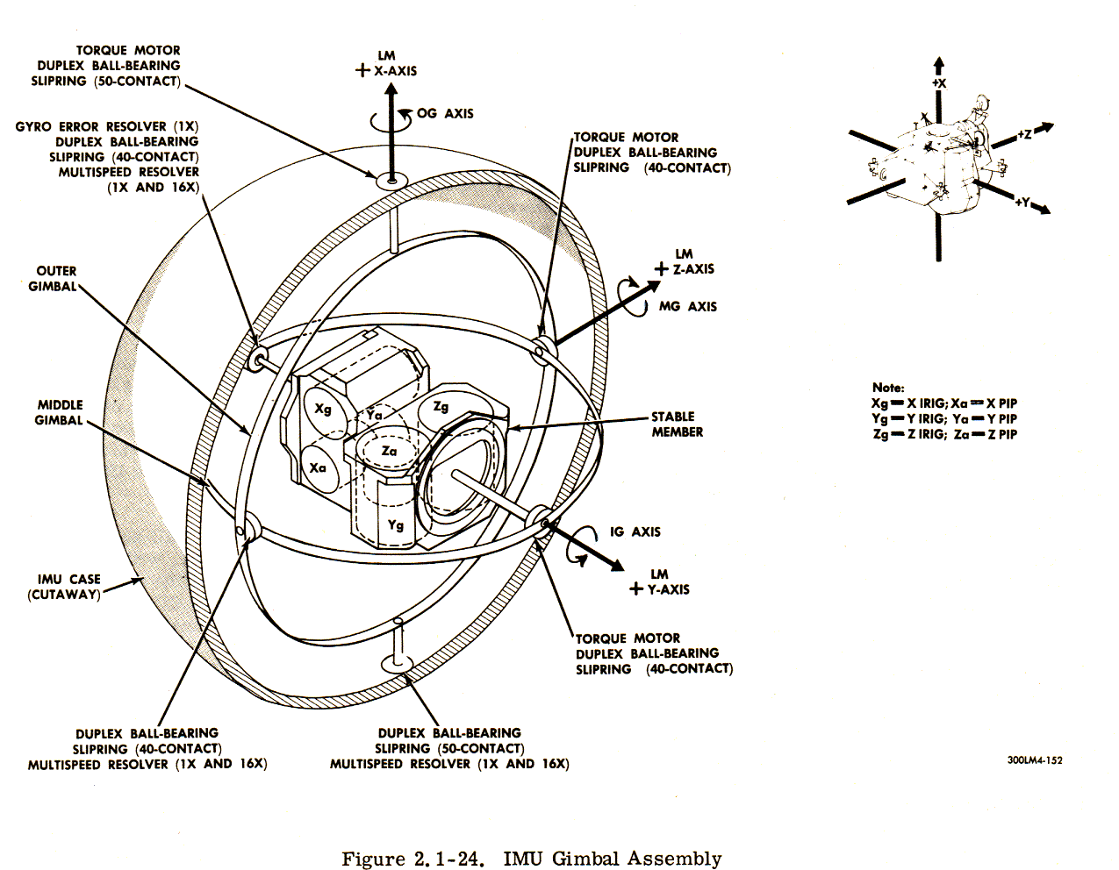
Gimble
Hardware implementation of Euler angles
Aircraft, Camera

Slide 32
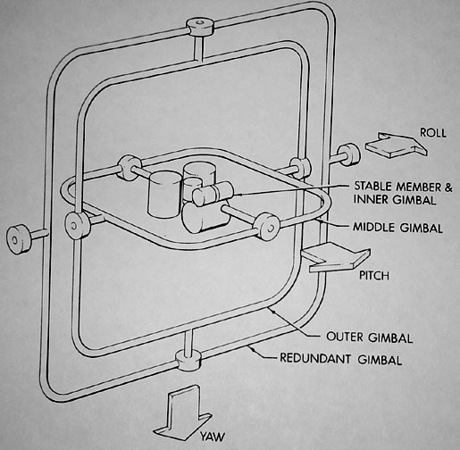
Euler Angles
Rotation about three orthogonal axes
12 combinations
XYZ, XYX, XZY, XZX
YZX, YZY, YXZ, YXY
ZXY, ZXZ, ZYX, ZYZ
Gimble lock
Coincidence of inner most and outmost gimbles’ rotation axes
Loss of degree of freedom

Slide 33
Euler angles
Arbitrary rotation can be represented by three rotation along x,y,z axis

Slide 34
Euler Angles
Euler angles are ambiguous
Two different Euler angles can represent the same orientation
This ambiguity brings unexpected results of animation where frames are generated by interpolation.

Slide 35
Smooth Rotation
Create transformations from M₀ to M_{n} smoothly
Problem: find a sequence of model-view matrices M₀,M₁,…..,M_{n} for each frame to see a smooth transition
One solution for rotation (using Euler angles):
Find R₀= R_{0z} R_{0y} R_{0x} and R_{n}= R_{nz} R_{ny} R_{nx}
Then, Create a sequence of rotation R₀,R₁,…..,R_{n} : R_{i}= R_{iz} R_{iy} R_{ix} (where, ix, iy, iz is the interpolated angles from the beginning and the end)
Not very effective!
Quaternions can do it better!

Slide 36
Quaternions
Extension of imaginary numbers from two to three dimensions
Requires one real and three imaginary components i, j, k
Quaternions can express rotations on sphere smoothly and efficiently. Process:
Model-view matrix → quaternion
Carry out operations with quaternions
Quaternion → Model-view matrix
q=q₀+q₁i+q₂j+q₃k
Computer Animation 수업에서 다룹니다.

Slide 37
Taxonomy of Transformations
Rigid
Affine
Projective

Slide 38
Composite Transformations
Composite 2D Translation

Slide 39
Composite Transformations
Composite 2D Scaling

Slide 40
Composite Transformations
Composite 2D Rotation

